Slide 1
Java Exception Handling

Slide 2
What is an Exception?
An Exception is run time problem or error which occurs, when program is under execution.
An Exception may occur due to Environment, bad programming, or due to unexpected input data.
For example:
When you access an array element which is beyond the range of array, an java.lang.ArrayIndexOutOfBoundsException is thrown.
In C Language there is no built in Exception handling, developer need to manually write the code to check the range
Purpose of Exceptions?
Exceptions improves User Experience
makes the Program more Robust.
Helps developer by generating basic Exception Handling code
Java has built in support for Exception handling.
Pre defined class

Slide 3
Java provides inbuilt Exception Handling as
5 keywords
Few inbuilt classes(Exception related classes)
Below are keywords used in Exception handling
1.try - set of program statements which may throw an Exception need to be enclosed within try block
2.catch – set of program statements which can handle Exception scenario need to be enclosed in catch block. A try block can have multiple catch blocks.
3.throw – throw keyword is used to manually throw an Exception. Is used in the method body.
4.throws – is used along with method declaration to specify that a method can throw one or more Exceptions. Is used with method declaration.
5.finally – statements in finally block gets executed whether are not Exception occurs. Generally releasing used resources, like closing file, network connections,etc… need to be done in finally block. finally block gets executed, before returning from the method , in all cases.

Slide 4
Exception class is base class of all Exception classes
eg. ArithmeticException,
NullPointerException,
ArrayIndexOutofBoundsException,etc…

Slide 5
Execution Flow when Exception occurrs
void met1()
{
//business logic
try{
//business logic
//exception occurred
//when above exception is thrown, these statements does not execute
}
catch(Exception et)
{
//statements in catch block gets executed only if exception occurs
}
}

Slide 6
Execution Flow when Exception does not occur
void met1()
{
//business logic
try{
//business logic
//full code in try block gets executed if exception is not thrown
}
catch(Exception et)
{
//if exception is not thrown, statements in catch block does not execute
}
}

Slide 7
Control Flow of Exceptions: Though the flow of program execution can be controlled using Exceptions.
Exceptions need to be used only to handle Exception Scenarios, and should not be used to actually control flow of execution of program.
java.lang.Exception is base class of all Exception classes.
Exception class has below methods.
1.printStackTrace()
Below are the exceptions related to memory
OutOfMemoryException – occurred when Heap memory is full
StackOverflowError – occurred when Stack memory is full
Both of above are Uncheck Exceptions

Slide 8
Difference between Exception and Error classes
The first one catches all subclasses of Throwable (this includes Exception and Error), the second one catches all subclasses of Exception.
Error is programmatically unrecoverable in any way and is usually not to be caught, except for logging purposes (which passes it through again). Exception is programmatically recoverable. Its subclass RuntimeException indicates a programming error and is usually not to be caught as well.
try{
}
catch(Throwable t){}
try{
}catch(Exception e){}

Slide 9
Exceptions are broadly classified into two
Checked Exceptions – These are the Exceptions which are checked by Compiler, and need to be handled(using try, catch) or thrown(using throws) explicitly.
All Checked Exceptions are derived from Exception class
UnChecked Exceptions – These are the Exceptions which need not be handled or thrown explicitly.
All Unchecked Exceptions are derived from RuntimeException class
Since forcing a developer to catch each and every Exception is not a good option, Java provides UnChecked exceptions. These are the exceptions which need not be explicitly handled by the developer.

Slide 10
Order of catching Exceptions
A try block can have zero or more catch blocks. When a try block has multiple catch blocks, the derived most Exceptions classes need to be caught first, and then Base Exception classes need to be caught
try{
//program statements
}
catch(ArrayIndexOutofBoundsException abe)
{
//
}
catch(Exception e)
{
//
}

Slide 11
List of some built in Exceptions
Below Exceptions are in java.lang package
Exception class name | purpose
NullPointerException
ArrayIndexOutofBoundsException
NumberFormatException
ArithmeticException
OutofMemoryError
StringIndexOutOfBoundsException
StackOverflowError
There a number of other Exceptions like SQLException, IOException, SocketException, etc…

Slide 12
Nested Exceptions
It is possible to have a try block within another try block.
A catch block can have another try catch blocks
try
{
//stmt 1
try{
//stmt 2
}catch(Exception et){ et.printStackTrace(); }
//stmt 3
}catch(Exception e)
{
e.printStackTrace();
}

Slide 13
Exception class Hierarchy
Object
Throwable
Error
Exception
RuntimeException

Slide 14
Exception class Hierarchy
In Java, exceptions are objects. When you throw an exception, you throw an object.
You can't throw just any object as an exception. you can throw only those objects whose classes descend from Throwable.
Throwable serves as the base class for an entire family of classes, declared in java.lang, that your program can instantiate and throw.
Throwable has two direct subclasses, Exception and Error.

Slide 15
Exception class Hierarchy
java.lang.Exception class represents the exceptions which are mainly caused by the application itself.
For example, NullPointerException occurs when an application tries to access null object or ClassCastException occurs when an application tries to cast incompatible class types.
Errors (members of the Error family) are usually thrown for more serious problems, such as OutOfMemoryError or StackOverflowError, that may not be so easy to handle.
In general, code you write should throw only exceptions, not errors.
Errors are usually thrown by the methods of the Java API, or by the Java virtual machine itself, due to environment issues.

Slide 16
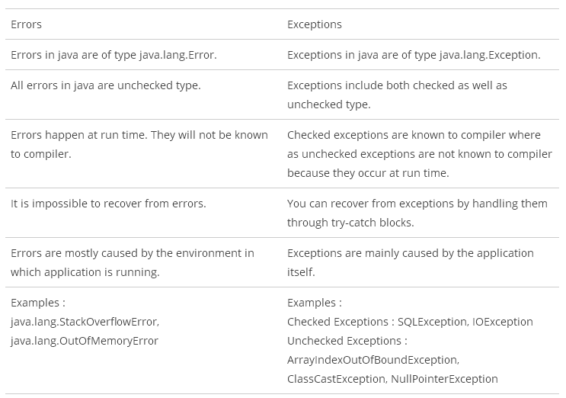

Slide 17
How to create user defined Checked Exception

Slide 18
How to create user defined UnChecked Exception

Slide 19
instance
obj1
obj2
Assigning one object to another
obj1
instance
Clone
obj2
Cloned instance
Fig. Cloning an object

